Slide 1


Smart, Secure, Seamless: Redefining Connected Vehicles with Salesforce Automotive Cloud, AI, Agentforce & Data Cloud
by
AgentPulse

Slide 2








Slide 3
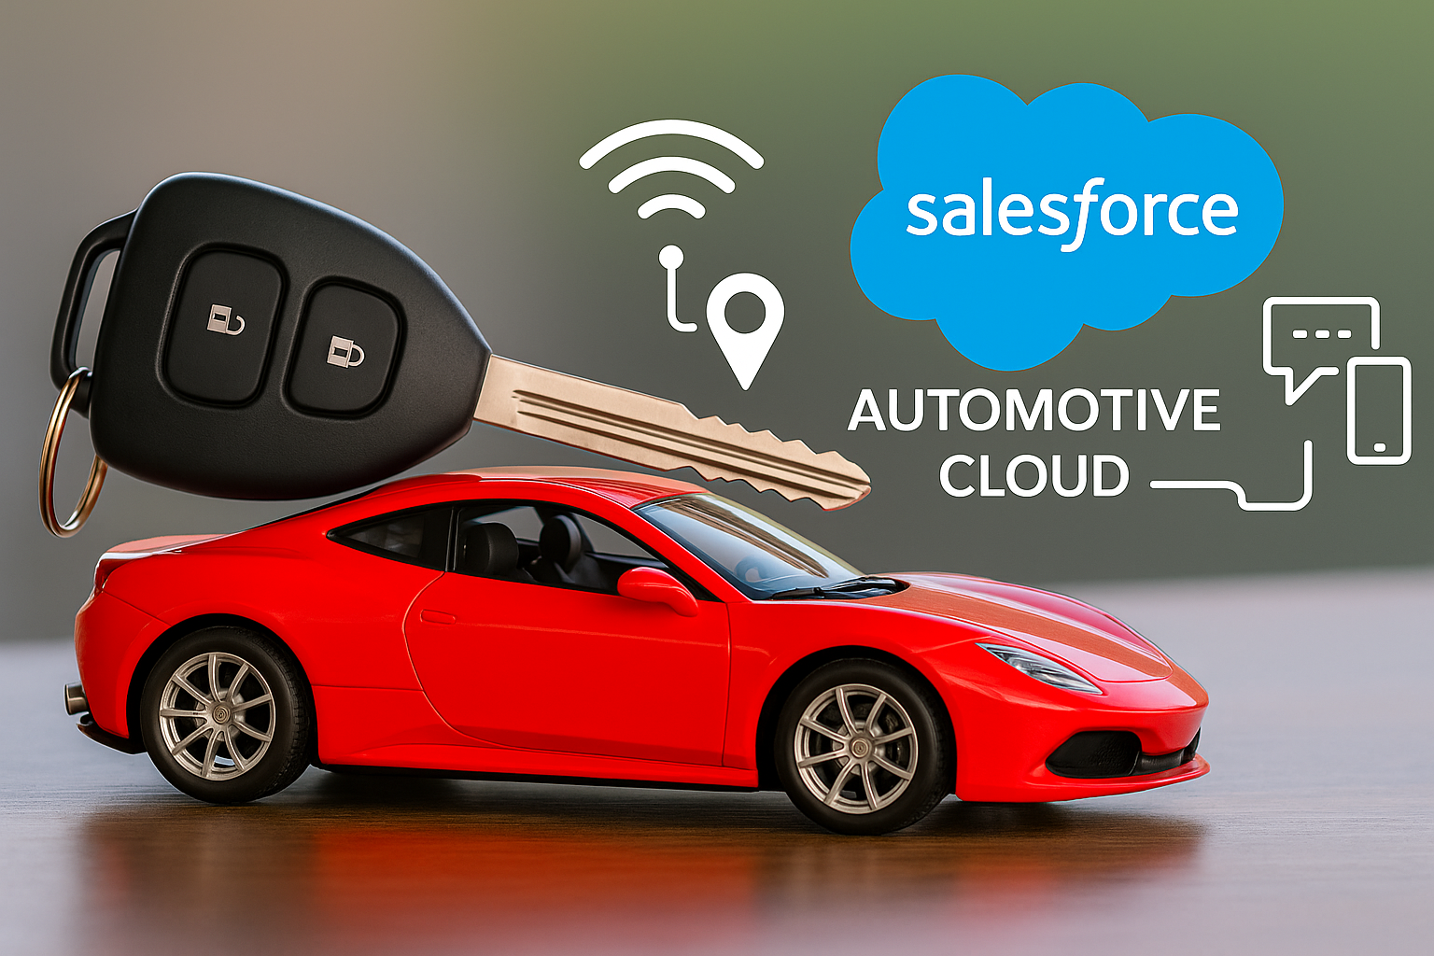
API Integration
Telemetry Data Insights
Automotive Cloud Record Alerts
Slack
Prompt Builder
Smart, Secure, Seamless: Redefining Connected Vehicles with Salesforce Automotive Cloud, AI, Agentforce & Data Cloud
AgentForce Service Agent

Slide 4
Vehicle Demo

Slide 5
API Integration
Telemetry Data Insights
Automotive Cloud Record Alerts
Slack
Prompt Builder
Smart, Secure, Seamless: Redefining Connected Vehicles with Salesforce Automotive Cloud, AI, Agentforce & Data Cloud
AgentForce Service Agent

Slide 6

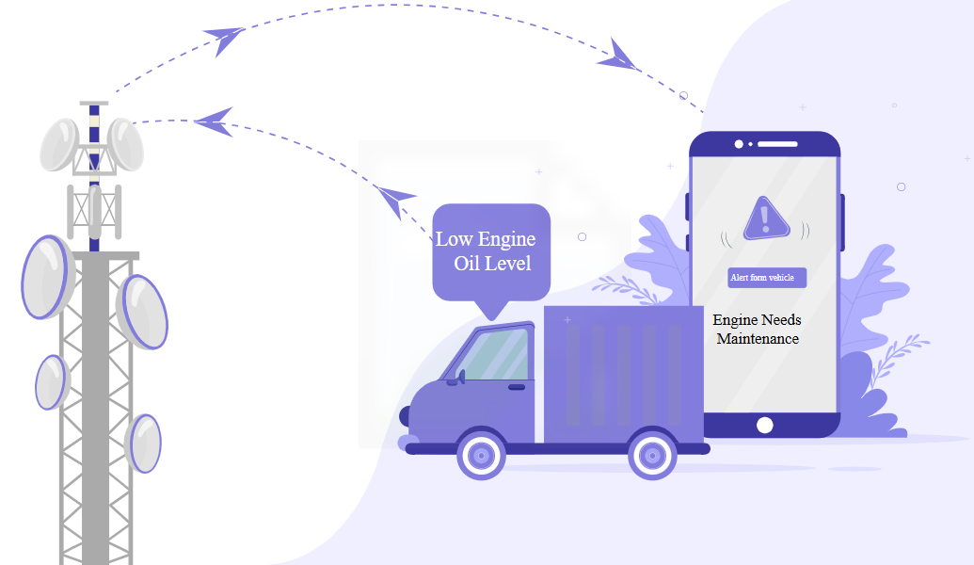


Leveraging Asset Telematics Event Model for Connected Vehicle Use Cases: For connected vehicle use cases, Salesforce Data Cloud provides the Asset Telematics Event Data Model object to capture actionable data and insights, enabling you to personalize notifications and track the health of the vehicle.
Case Study 1: Vehicle Health Alert Framework

Slide 7
API Integration
Telemetry Data Insights
Automotive Cloud Record Alerts
Slack
Prompt Builder
Smart, Secure, Seamless: Redefining Connected Vehicles with Salesforce Automotive Cloud, AI, Agentforce & Data Cloud
AgentForce Service Agent

Slide 8
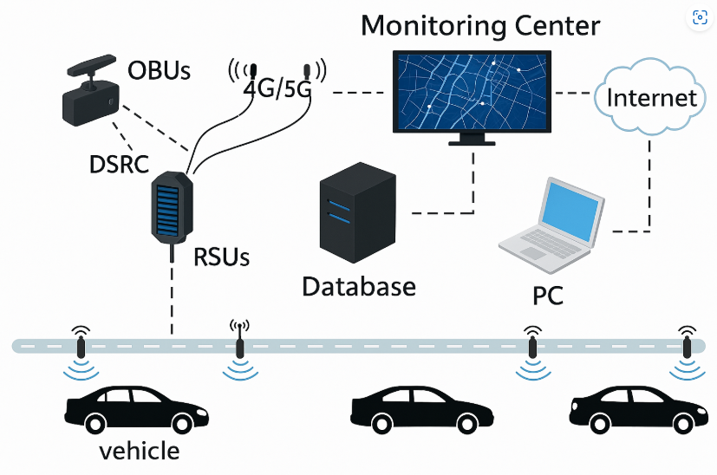
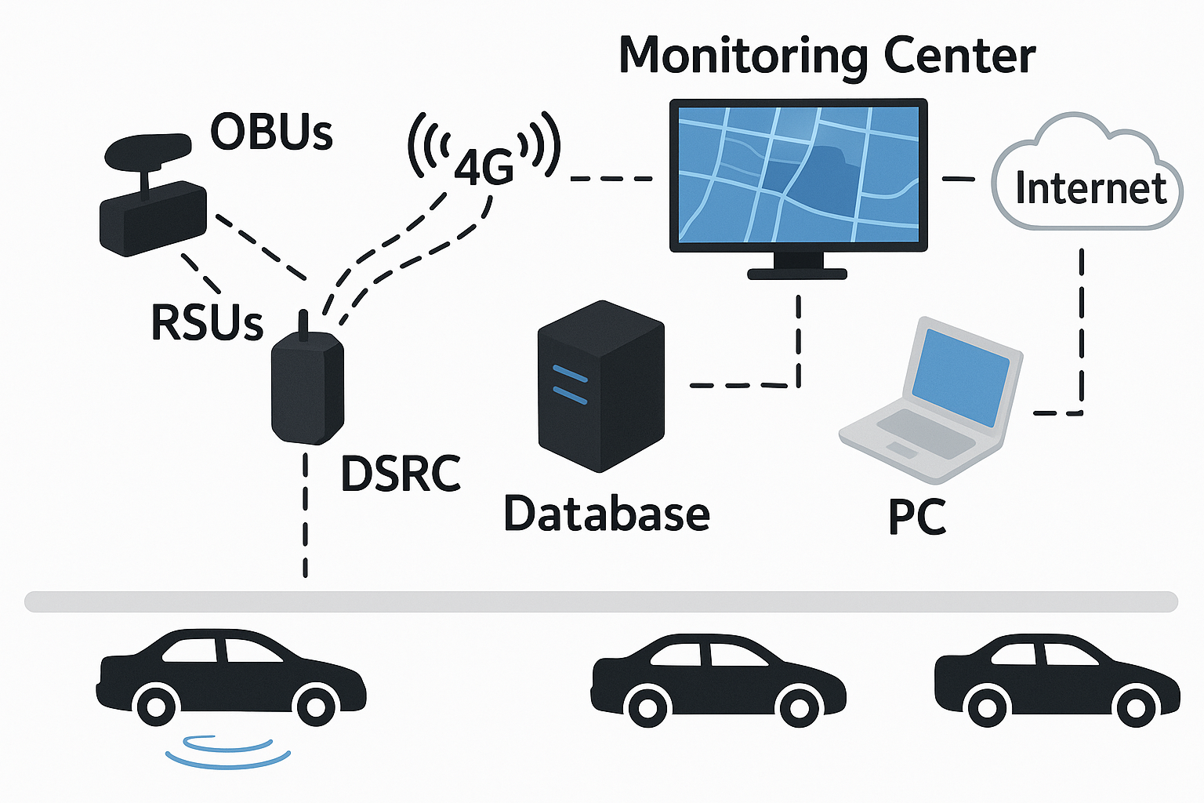

Using Record Alerts in Automotive Cloud to Safeguard Vehicles and Drivers from Critical Issues: Record alerts in Automotive Cloud provide timely notifications to keep users informed about critical issues, helping to protect both vehicles and drivers. These alerts proactively address potential problems and warnings. Service technicians, sales representatives, and service dealers can view alerts related to warranty expiration, scheduled maintenance, repairs, lease extensions, and more. This feature can be seen as a next-generation capability for enhanced protection.
Case Study 2: Proactive Safety Solution via Smart Vehicle and Driver Record Alerts

Slide 9
API Integration
Telemetry Data Insights
Automotive Cloud Record Alerts
Slack
Prompt Builder
Smart, Secure, Seamless: Redefining Connected Vehicles with Salesforce Automotive Cloud, AI, Agentforce & Data Cloud
AgentForce Service Agent

Slide 10


Saving Lives with Slack: Real-Time Alerts for Rapid Rescue — Powered by Salesforce: In critical situations, every second matters. By integrating real-time alerts through Slack with the power of Salesforce, rescue teams receive instant notifications and valuable insights. This seamless connection ensures that organizations can respond quickly and efficiently, saving lives when it counts the most. Salesforce’s robust CRM capabilities provide smooth communication and real-time tracking, enabling faster decision-making for a more effective response. Together, Slack and Salesforce create an integrated system for rapid, life-saving action.
Case Study 3: Proactive Safety Framework with Slack: A Smart Alert System for Real-Time, Life-Saving Risk Prevention

Slide 11
API Integration
Telemetry Data Insights
Automotive Cloud Record Alerts
Slack
Prompt Builder
Smart, Secure, Seamless: Redefining Connected Vehicles with Salesforce Automotive Cloud, AI, Agentforce & Data Cloud
AgentForce Service Agent

Slide 12

Breakdown to Breakthrough: Smarter Vehicle Support with Salesforce Prompt Builder
We’ve leveraged Salesforce’s Gen AI Prompt Builder in multiple impactful ways:
1. Intelligent Email Automation:
The Prompt Builder auto-generates dynamic, context-aware emails for key vehicle scenarios such as service due alerts, oil changes, breakdowns, and accident notifications. By pulling from dynamic attribute values, it reduces manual effort and boosts customer engagement with timely, personalized communication.
2. AI-Powered Record Summary:
Widely adopted across industries, the Record Summary feature delivers concise, AI-generated overviews of detailed records—providing an eagle-eye view in a fast-paced world. Using over 50 fields, this built-in Salesforce AI capability transforms how data is consumed and understood, offering rapid insights and decision-making power. It's poised to be a game changer in the evolving AI ecosystem.
We also make use of Salesforce's out-of-the-box automation tool, Flows, which triggers instantly on record alerts to streamline processes and accelerate response times.
With support for advanced AI models such as Azure OpenAI GPT and OpenAI’s GPT, Salesforce ensures robust, future-ready integration and intelligent automation at scale.

Slide 13
API Integration
Telemetry Data Insights
Automotive Cloud Record Alerts
Slack
Prompt Builder
Smart, Secure, Seamless: Redefining Connected Vehicles with Salesforce Automotive Cloud, AI, Agentforce & Data Cloud
AgentForce Service Agent

Slide 14



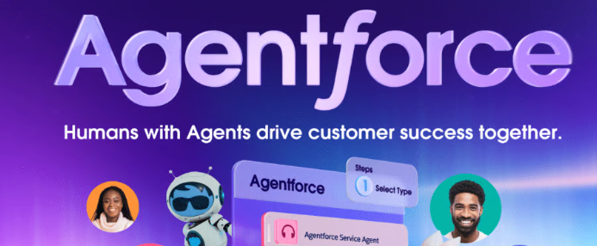
Agentforce is Salesforce’s innovative low-code platform designed for automotive companies to easily build, customize, and deploy autonomous agents that streamline service case creation, enable Live Agent Connect for breakdowns, and deliver AI-powered record summarization.

